Slide 1
Cours d’aide à la décision multicritère
Page web
http://homepages.ulb.ac.be/~bmaresc/ensta.html
Travail de groupe (2 à 3 étudiants)
Pour le 10/11/2014, préciser par mail à bmaresc@ulb.ac.be
La composition du groupe
L’entreprise retenue
Le cadre du problème à traiter (actions, critères)
Le 12/11/2014, courte présentation (5 min.) et discussion.

Slide 2
Tableau multicritère
Au moins 6 actions
Au moins 5 critères
Critères
Quantitatifs
Qualitatifs
Problématique
Sélection d’une action
Sélection multiple sous contraintes
Evaluation
Différents points de vue, scénarios

Slide 3
Visual PROMETHEE WWW.PROMETHEE-GAIA.NET
3-level simple hierarchical criteria structure.
New visual tools:
PROMETHEE rankings and Diamond,
Visual Weight Stability Intervals,
Decision-maker’s Brain (PROMETHEE VI),
GAIA-3D,
GAIA-Webs and PROMap GIS integration,
Performance (input-output) analysis, …

Slide 4
MCDA vs Optimisation
Optimisation
MCDA
Economic
Single criterion:
Profit
Profit, Social, Environment, …
Equitable
Viable
Sustainable
Social
Environment
Bearable
Short-sightedness
Sustainable Decisions
Crisis

Slide 5
Some Decision or Evaluation Problems
Locating a new plant, a new shop, ...
Human resources management.
Purchasing equipment.
Assessing the quality of suppliers.
Evaluating projects.
Selecting an investment strategy.

Slide 6
Some applications at ULB
Financial evaluation of companies
Quality assessment of suppliers
Electricity production planning at Electrabel
Regional planning
Evaluation of urban waste management systems
Environmental applications
Health care:
Evaluation
Therapeutical choice
Hospital management
...

Slide 7
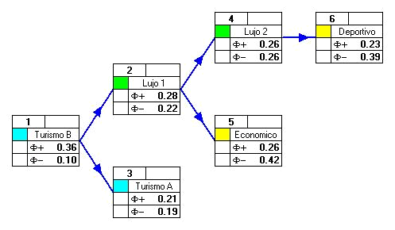
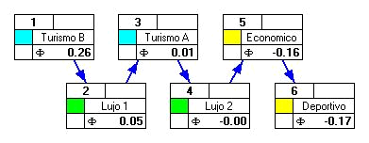
PROMETHEE
Rank decisions from the best to the worst ones.
Identify best compromise solutions.

Slide 8
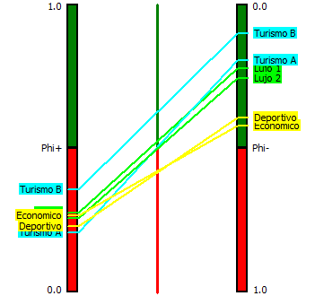
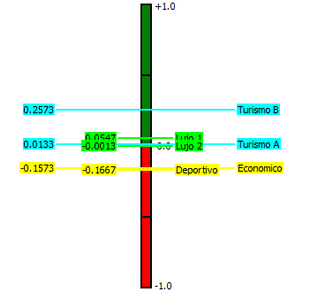
PROMETHEE I & II
PROMETHEE I : partial ranking –
PROMETHEE II : complete ranking –

Slide 9
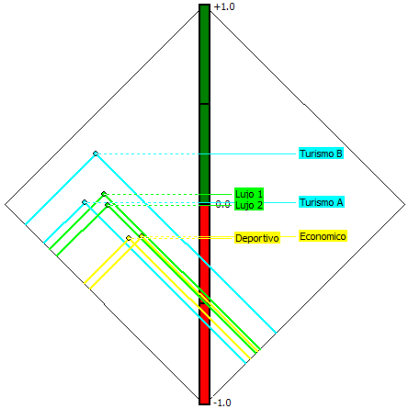
PROMETHEE Diamond

Slide 10
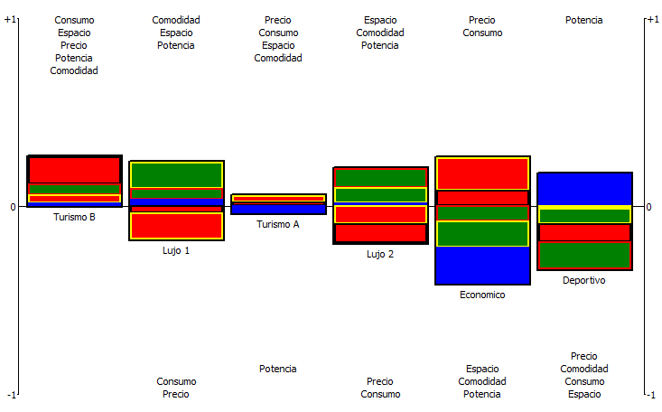
PROMETHEE Rainbow

Slide 11
Sensitivity Analysis with PROMETHEE
Criteria weights ↔ PROMETHEE ranking.
Interactive weight sensitivity analysis: « Walking Weights ».
Robustness with respect to weight values?
Weight stability intervals.
Visual weight stability intervals.
Notes:
When the weights of the criteria are modified, the position of the decision axis changes in the GAIA plane. It reflects the type of compromise that is proposed by PROMETHEE.
The Walking Weights interactive procedure makes it easy to do such an analysis.
To better appreciate the robustness of the PROMETHEE rankings it is also possible to represent the area in the GAIA plane where the tip of the decision axis moves when the weights are changed within specified limits. That is GAIA-Brain.

Slide 12
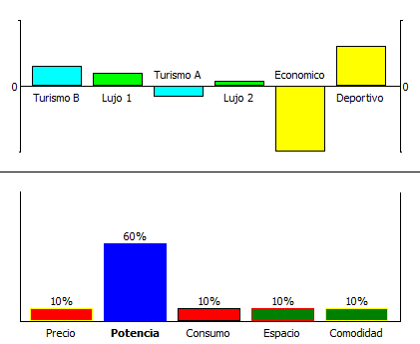
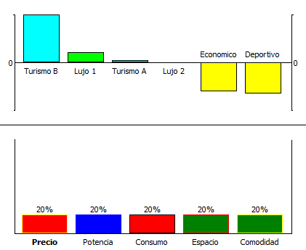
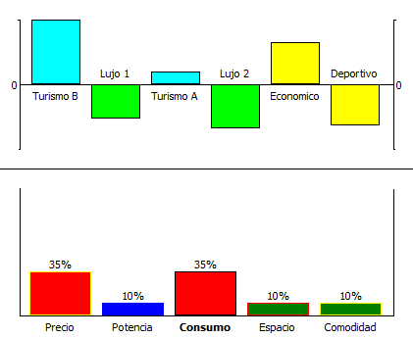
Walking Weights

Slide 13
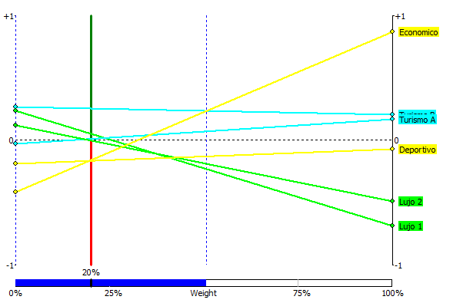
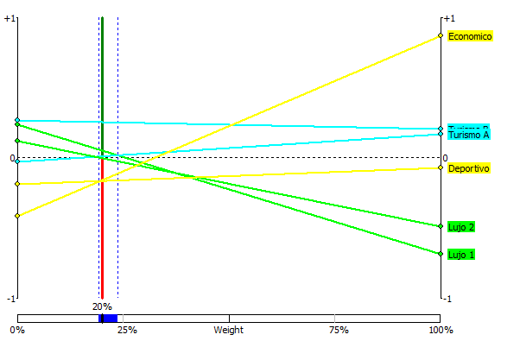
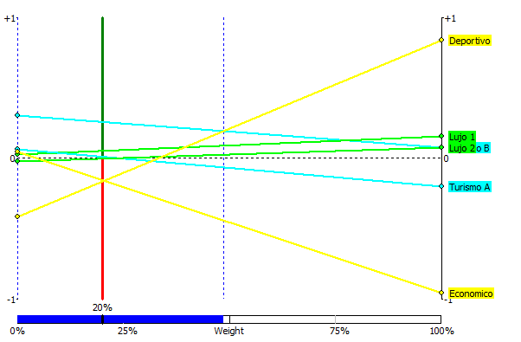
Visual Stability Intervals
VSI for « Precio » (level 1): [ 0.00% , 50.68% ]
VSI for « Precio » (level 6):
[ 19.20% , 23.70% ]
VSI for « Potencia » (level 1): [ 0.00% , 48.65% ]

Slide 14
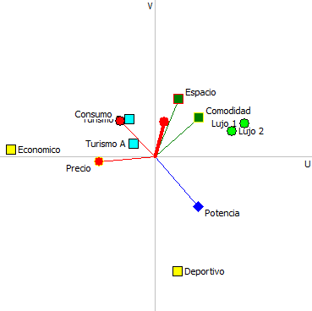
GAIA
Discover conflicts among criteria.
Identify potential compromises.
Help to fix priorities.

Slide 15
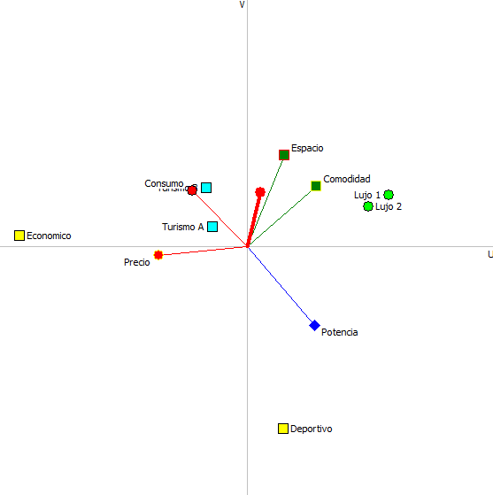
GAIA
Actions: points
Criteria: axes
Δ = 90%

Slide 16
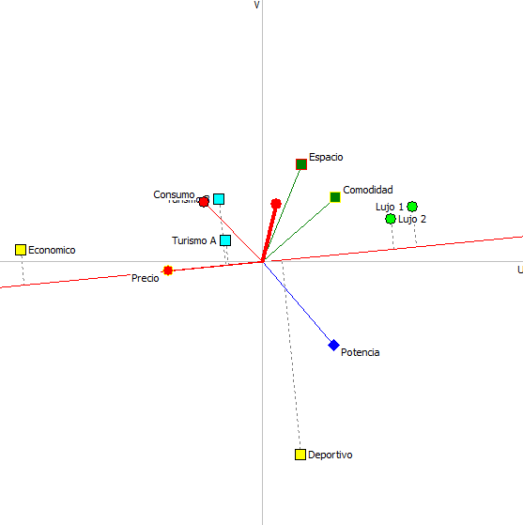
GAIA
Precio
Economico: 15 k€
Turismo: 25,5-26 k€
Deportivo: 29 k€
Lujo: 35-38 k€
Δ = 90%

Slide 17
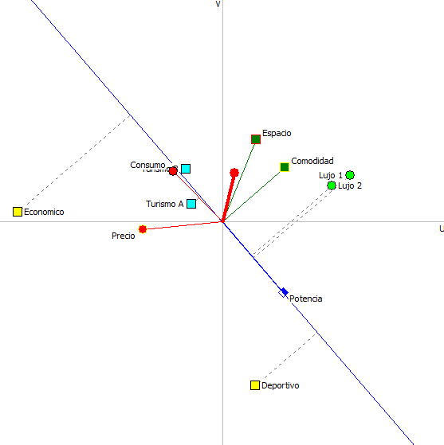
GAIA
Potencia
Deportivo: 110 kW
Lujo: 85-90 kW
Turismo: 75-85 kW
Economico: 50 kW
Δ = 90%

Slide 18
GAIA
Actions: points
Criteria: axes
Decision axis
PROMETHEE II !
Turismo B : 0,26
Lujo 1 : 0,06
Turismo A : 0,02
Lujo 2 : 0,00
Economico : -0,15
Deportivo : -0,17
Δ = 90%

Slide 19
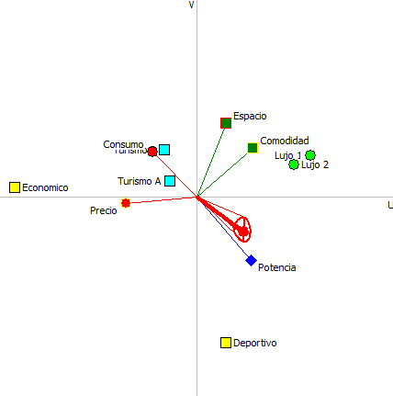
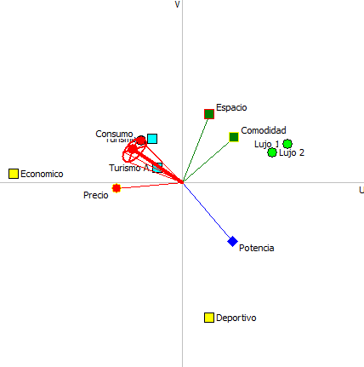
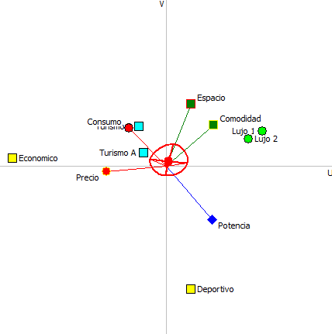
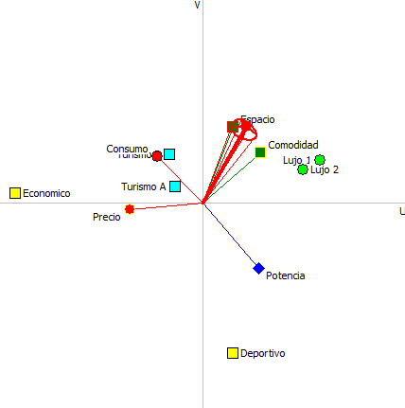
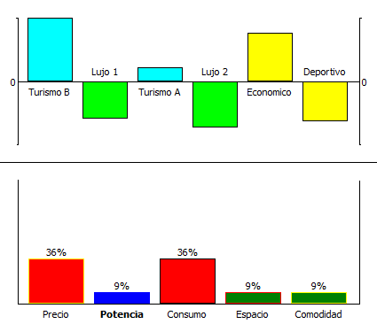
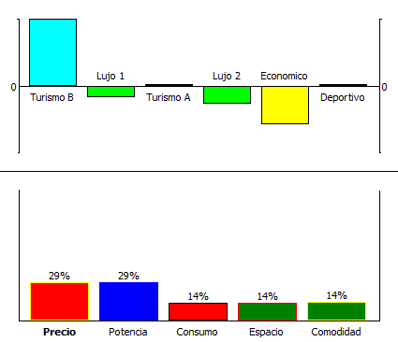
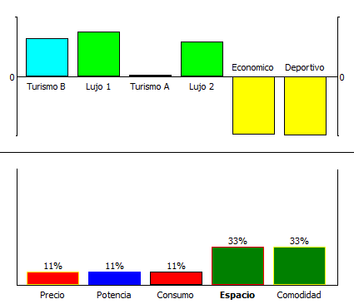
GAIA-Brain
20 years old
35 years old
Notes:
In the leftmost example, the « brain » is located in the SW direction and it is small: within these weight variations, the PROMETHEE ranking will not change so much.
In the central example, the « brain » is large and overlaps the origin: the decision axis can point in any direction and the PROMETHEE ranking could be quite sensitive to weight variations.
The two rightmost examples correspond to smaller « brains » oriented in different directions.

Slide 20
GAIA
Actions: points
Criteria: axes
Decision axis
!! only Δ % information !!
Δ = 90%

Slide 21
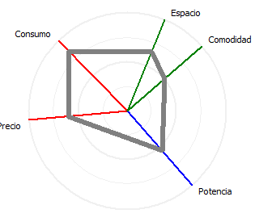
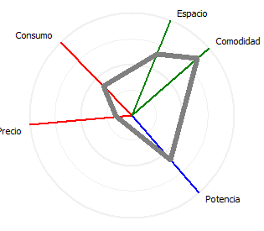
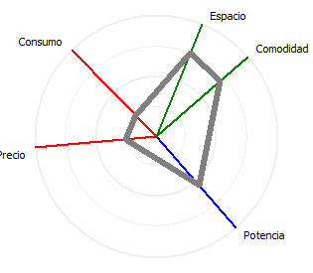
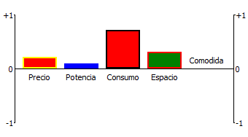
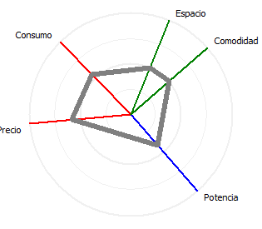
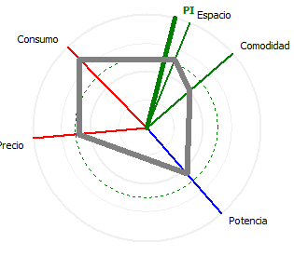
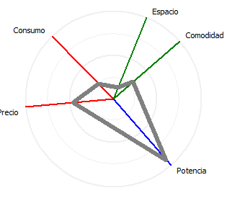
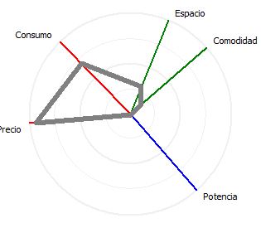
GAIA Webs
Lujo 1
Lujo 2
GAIA Web – Turismo B
Action profile – Turismo B
Turismo A
Turismo B
Deportes
Economico

Slide 22
Multi-scenarios model
Scenarios:
Points of view,
Hypotheses, …
Evaluations:
‘Objective’ criteria: common evaluations.
‘Subjective’ criteria: specific evaluations for each scenario.
Specific preference structures :
Weights, preference thresholds.

Slide 23
Multi-scenarios model
Adaptation of PROMETHEE:
Individual rankings.
Global (group) rankings taking into account a possible weighing of the scenarios.
Adaptation of GAIA:
Three distinct analyses.

Slide 24
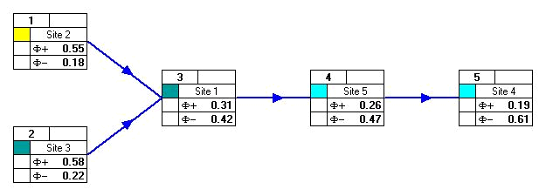
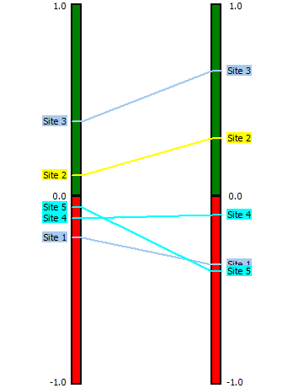
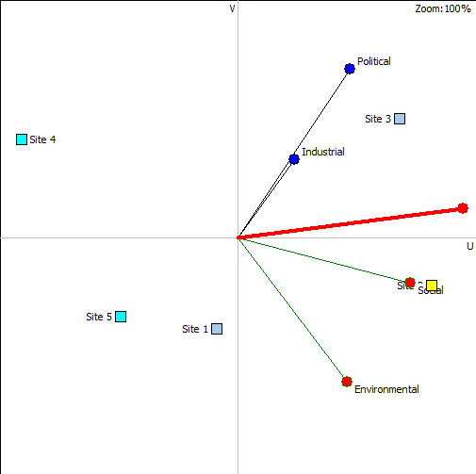
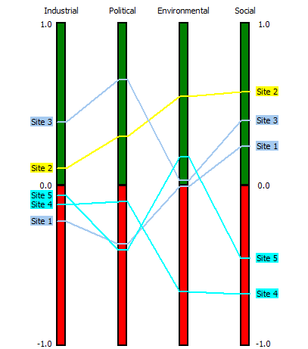

Slide 25
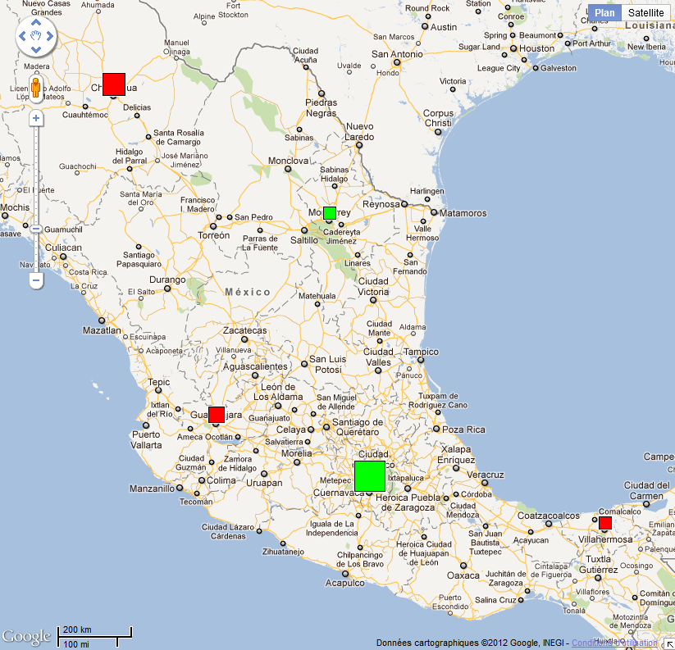
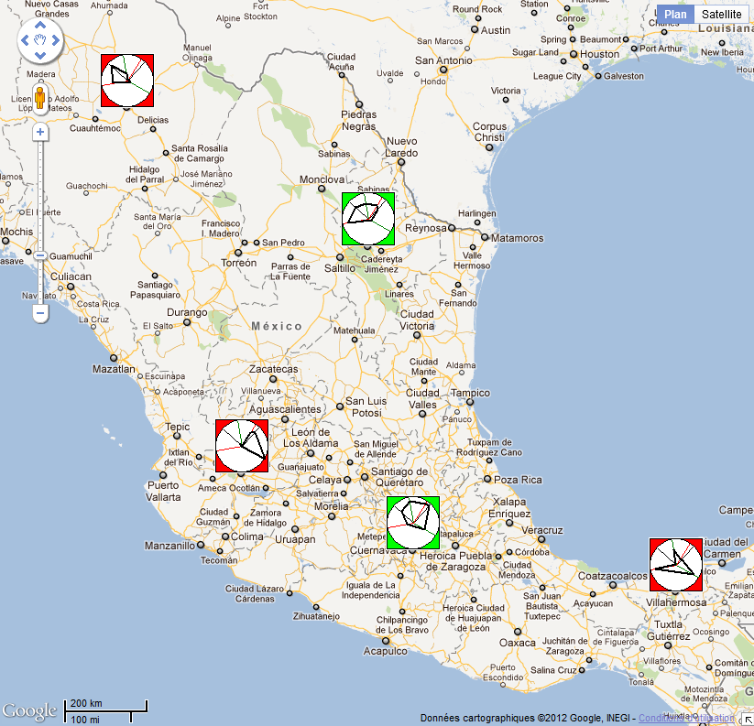
PROMap
Google Maps integration:

